Slide 1

Stephane Chretien
stephane.chretien@gemalto.com
Smart Cards and
Java Card Programming
Java Card 3.0 Programming

Slide 2

Presentation objectives
Introducing the concepts and the technology of the smart cards
Describing the protocols between cards and terminals
Describing how to program the Java Cards
Exploring the tools and the environments provided by the manufacturers to develop solutions with smart cards
•
Java Card 3.0 Programming

Slide 3
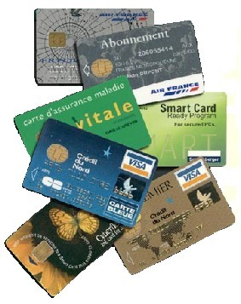

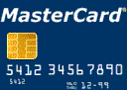
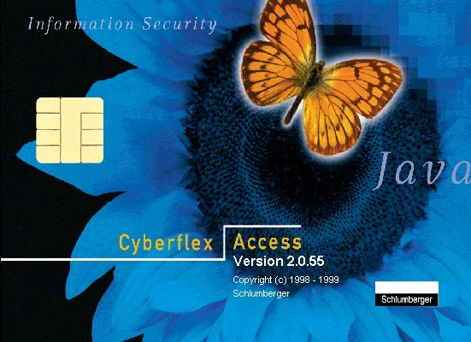
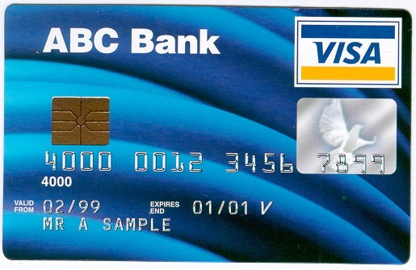

Presentation content
Introduction
ISO7816 Protocol
Java Card
The basic rules for Java Card programming
Cyphering
SIM Card
Smart Card Web Server
Java Card 3.0 Connected Edition
Conclusion
Java Card 3.0 Programming

Slide 4
Introduction
History, technology, standards
Java Card 3.0 Programming

Slide 5
Introduction
●
In this chapter, we'll see
●
A brief history of the smart cards
The applications supported by the smart cards The standards supported
●
●
Java Card 3.0 Programming

Slide 6
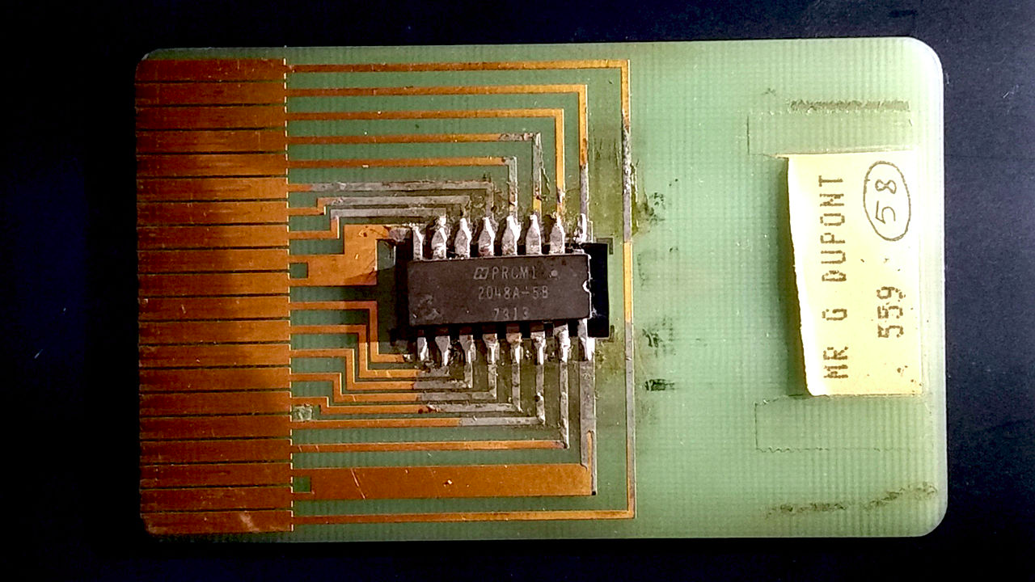
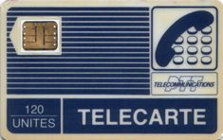
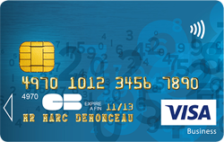
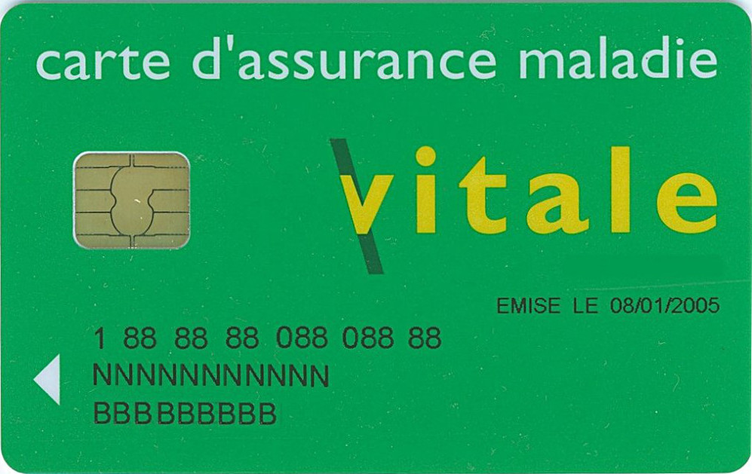
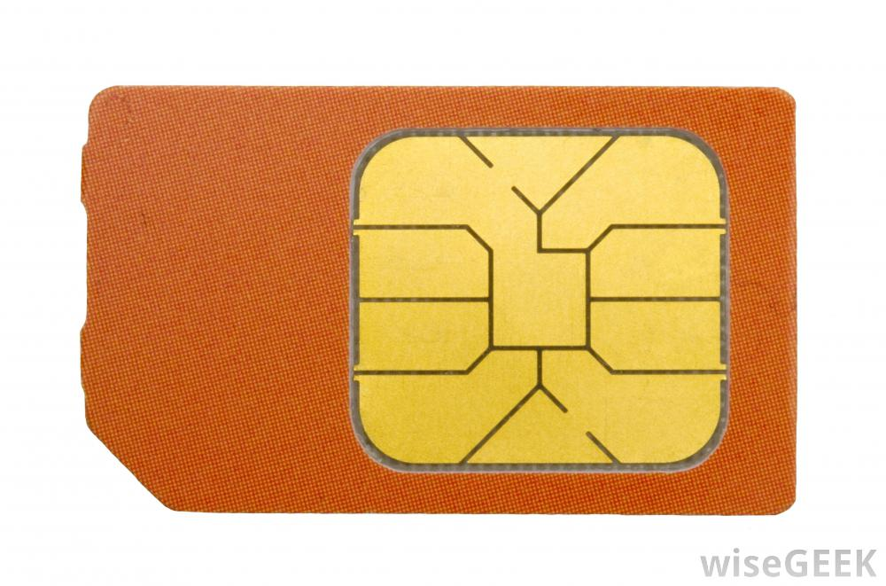
Brief history
Early seventies, first patents
Dr Arimura, R Moreno, M Ugon
Early eighties, first field testing for a memory card
Phone card in France
Mid eighties, large scale introduction of smart cards in banking system
Mid nineties, SIM card introduced in mobile telephony
End nineties, VITAL card introduced in france
Java Card 3.0 Programming
Notes:
1976 la 1er carte a puce microcircuit est developpe : Bull
1978 la 1er carte avec micro-pro
Pouvoir francais on soutenu deux project
Carte bancaire=> EMV
Carte telephonique => PTT

Slide 7



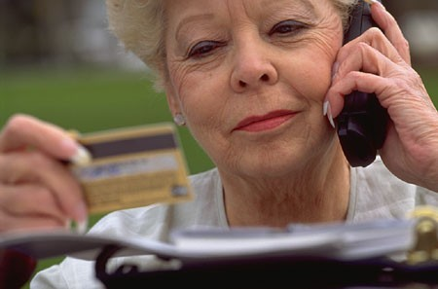
What is a smart card
A plastic card like a credit card with an embedded micro chip
With or without visible contacts
Maybe contactless
Standardized
– ISO 7816
Mecanical properties
Electrical behavior
Communication protocol
Contains a software which
Protects internal data (Keys, Money, ..)
Give access to these data in a secure way ➔ Authentication (PIN, …)
Perform sensitive and cryptographic operation
Java Card 3.0 Programming

Slide 8






For what applications …
Payment (ePurse, EMV)
Loyalty systems
Access control
Telephony
- Mobile (GSM …)
e-Government
– ID card, passport
File system
Health (carte vital)
Education
– …
Java Card 3.0 Programming

Slide 9
Architecture
Crypto
ROM
(Operating System)
reset
CPU
CLK
RAM
(temp / transient storage)
UART
(I/O System)
I/O
VCC
NVM / EEPROM / FLASH
(application storage)
CPU : 8/16/32 Bits from 3.57Mhz to 24Mhz
RAM : 1KB to 24KB
NVM : few KB of EEPROM to 128MB of NAND Flash

Slide 10

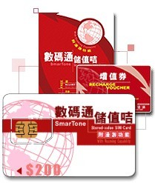

Standards
• ISO 7816
• GSM 11.11 V6.1.0
• GSM 11.14 V7.1.0
- SIM Toolkit specs
• GSM 03.19 V1.0.0
- SIM API for Javacard
ETSI
– TS 31 130
– TS 102 241
– TS 102 588
Java Card
Java Card Forum
EMV
Europay, Mastercard, Visa
Global Platform
Java Card 3.0 Programming
Notes:
11.11 => SIM and high level description of command
11.14 => allow interaction with end user
03.19 => SIM API Javacard specification
102 241 =>

Slide 11
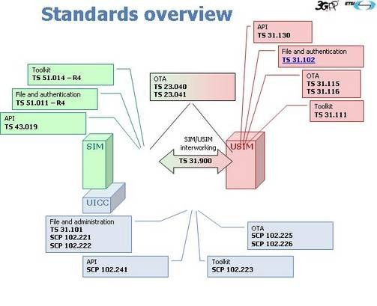
Standards
SIM = Subscriber Identity Module ➔ GSM standard
USIM = Universal Subscriber Identity Module ➔3G, LTE,..
UICC = Universal Integrated Circuit Card ➔ a smartcard
Java Card 3.0 Programming

Slide 12
Conclusion
●
In this chapter, we have seen
●
A brief history of the smart cards
The applications supported by the smart cards The standards supported
●
●
Java Card 3.0 Programming

Slide 13
ISO7816 Protocol
Physical description, communication layer,
file system
Java Card 3.0 Programming

Slide 14
Introduction
In this chapter, we'll see
An introduction to the ISO7816 standard
What is an APDU
How to exchange data between the CAD and the smart card
●
Java Card 3.0 Programming

Slide 15
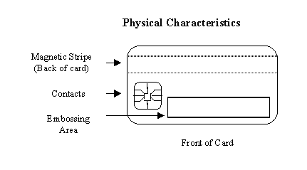
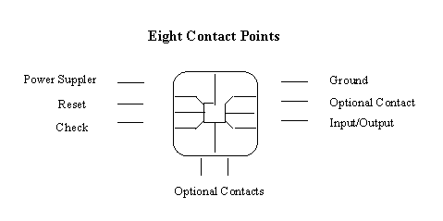
Mechanical and Electrical Aspects
ISO 7816 standard describes
Physical and Electrical characteristics
Transmission protocol
Security and Command exchange
File System
…
Possible power voltage
3V or 5V
Lower maybe in the future
Clock
Java Card 3.0 Programming

Slide 16
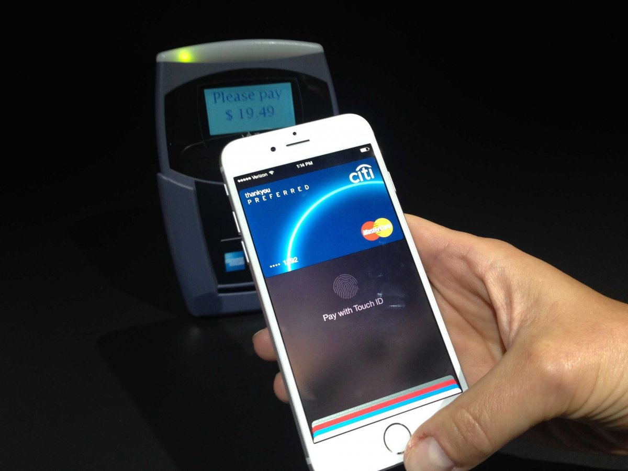
USB and NFC port
●
Added to the SIM card standard
●
A USB port in place of the two optionnal contacts on the bottom of the circuit
A NFC (Single Wire Protocol) port for the last optionnal contact
NFC SWP
●
USB Port
NFC = Near Field Communication
Java Card 3.0 Programming

Slide 17

Half-duplex serial protocol
Due to the unique pin dedicated to input/output, the first protocol used by the smart cards were
Serial
Half-duplex
Communication characteristics:
Data: 8 bits
Parity: even
Stop: 1 bit
Speed starting at 9600 Bps to 115200 Bps
C0 00 00 02 10 00
Input / Output
Java Card 3.0 Programming

Slide 18
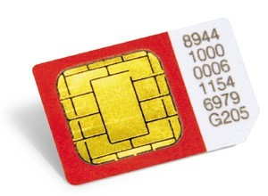
USB IC
ETSI TS 102.600
Max speed 12 Mb/s Three flavours:
●
●
●
Integrated Circuit Card Devices
Compatible with the previous serial protocol
Mass Storage
–
●
–
Disk emulation
●
Ethernet Emulation Mode
–
To support TCP/IP protocol
Java Card 3.0 Programming

Slide 19


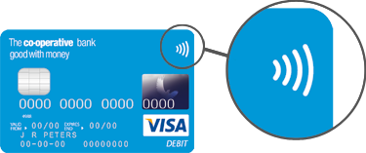
NFC SWP
ETSI TS 1002.613 & 622
Single Wire Protocol Full duplex
●
●
●
Current and voltage modulation
●
Max speed 1.6 Mb/s
The smart card can act as
●
●
A RFID tag
A RFID tag reader
●
Java Card 3.0 Programming

Slide 20

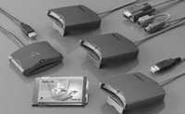
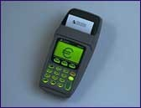
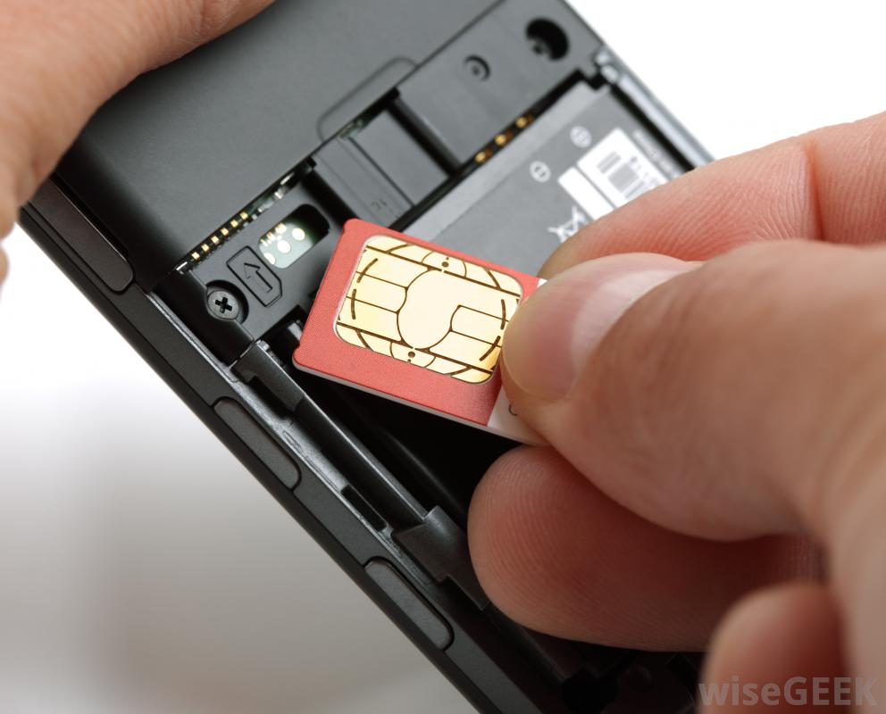
Terminology
The smart card reader powered by
a PC
a cash register
a mobile phone
is called a terminal
In the standard ISO 7816 it is called :
The Card Acceptance Device
Or CAD
Java Card 3.0 Programming

Slide 21
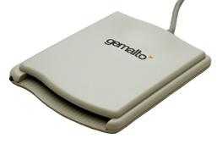
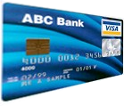
Answer to Reset
When a card is inserted into the reader, a micro-switch signals this event to the terminal.
The terminal powers up the card
– Using a particular protocol
When it is properly powered, the card sends back to the terminal a message called "Answer to Reset"
reader
Smartcard
Power up
Answer to Reset
Supported protocol
Supported Voltage
Speed
Type of card
Card manufacturer
Java Card 3.0 Programming

Slide 22
General protocol
After sending Answer to Reset, the card waits until the terminal starts a communication
The card never starts a communication
The card answers to a demand coming from the terminal and waits for the next demand
The receive a APDU Command and respond with APDU Response
APDU = Application Protocol Data Unit
reader
Smartcard
Wait for next
command
APDU Command
Execute
command
APDU Response
APDU Command = Header + Data
APDU Response = Data + Status Word
Java Card 3.0 Programming

Slide 23
Application Protocol Data Unit Command
CLA
INS
P1
P2
LC
LE
The APDUs are the commands sent by the terminal to the smart card
The APDU can
Carry optionaly data to the card, Max : 255 bytes
Expect results from the card
Card and terminal must synchronize to
The number of bytes to exchange
The direction of the exchange
This is done by the software embedded in each device
Header
of
5 bytes
Body Data
Of
LC bytes
DATA
Java Card 3.0 Programming

Slide 24
Application Protocol Data Unit
CLA
INS
P1
P2
LC
LE
Class of the APDU: one byte which is caracteristic of the APDU of the application
Instruction: this is the command
P1, P2: two parameters which can be combined to form a short integer
DATA
LC: length of data which will be exchanged between the terminal and the card (from the ter- minal to the card, or from the card to the terminal)
LE: length of data Excepected which will be exchanged between the card and the terminal (only in case LC is provided)
Java Card 3.0 Programming

Slide 25
Application Protocol Data Unit Response
SW1
SW2
Response
Body
Of
LE bytes
Carry optionally Data, Max 256 bytes
SW1SW2 is the Status Word
report the result of the operation done by the card
SW1=0x90 SW2 =0x00 means success!
When different, could indicate
Denied access
File not found
No such CLA or INS expected
– …
DATA
0x9000
Java Card 3.0 Programming

Slide 26
Case 1 : No Data Exchanged
• LC ==0
The card receives the APDU header only
It processes it
It returns a status word
– Two bytes
reader
Smartcard
Wait for next
command
CLA|INS|P1|P2|00
Execute
command
SW1|SW2

Slide 27
Case 2: Data Sent by Terminal
LC ≠ 0
LC indicates the length of the data in bytes
The software in the terminal and the software in the card must agree on the direction of the exchange
The card acknowledges by sending back the INS byte
– Simple case
reader
Smartcard
Wait for next
command
CLA|INS|P1|P2|LC
INS
DATA
Execute
command
SW1|SW2

Slide 28
Case 3: Data Sent by Card
LE ≠ 0
The 5th byte is called LE in this case
The card acknowledges the APDU by sending back the INS byte
Simple case
reader
Smartcard
Wait for next
command
CLA|INS|P1|P2|LE
INS
Execute
command
DATA
Data are returned by the card, followed by the status word
SW1|SW2

Slide 29
Conclusion
In this chapter, we have seen
An introduction to the ISO7816 standard What is an APDU
How to exchange data between the CAD and the smart card
●
●
●
●
Java Card 3.0 Programming

Slide 30
Cours 2 : Java Card
Java Card Forum, history of the versions, programming aspects
Java Card 3.0 Programming

Slide 31
Introduction
●
In this chapter, we'll see
An introduction to the Java Card system What is a Java Card Applet
What is the Java Card Runtime Environment The lifecycle of an Applet
How to protect access with an OwnerPIN
●
●
●
●
●
Java Card 3.0 Programming

Slide 32

Operating systems
Beginning: proprietary systems
Only the applications were standardized
B0' for French banking system
Now: multi-application systems
MULTOS
Java Card
•
Java Card 3.0 Programming

Slide 33


Java Card History
Early 1996
First development
Schlumberger, Bull CP8, GemPlus, Sun
Schlumberger's Cyberflex
Java Card Forum
Most of the smart cards manufacturers
Sun
– As a Java guru
Java Card 3.0 Programming

Slide 34

Why Java in a smart card
Java is an interpreted language
– Need a Java Virtual Machine to run
Applications could be portable from one smart card to another
Applications run securely in a "sand box"
Small footprint for the applications
•
Java Card 3.0 Programming

Slide 35

Is Java for Java Card pure Java?
No until Java Card 3.0!
Roughly:
Basic types restricted to
Boolean
Small integers
Byte
Short
Int (optional)
No Strings
Arrays restricted to one-dimensional arrays
Limited libraries
Including java.lang
–
No garbage collector
Less restrictions for Java Card 3.0
Java Card 3.0 Programming

Slide 36
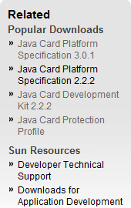
Which version in this course?
In this course we will introduce the Java Card 3
Classic Edition
Java Card 2.2.2
Connected Edition
Java Card 3.0 Programming

Slide 37
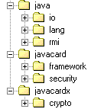
Available libraries
Basically, javacard and javacardx
contain the smart card API
–
framework, security and crypto
•
java.lang is reduced mainly to the exception definitions
java.io and java.rmi was introduced in the last 2.2 version
•
–
–
java.io to manage channels
java.rmi to manage remote method invocation
Java Card 3.0 Programming

Slide 38

SIM Toolkit
For SIM Toolkit two more packages
access
toolkit
Will be detailed later
Java Card 3.0 Programming

Slide 39

How Java works in a smart card
A Java Virtual Machine is embedded
4 K bytes
Basic library
Java Card Runtime Environment
In charge of
Activation and selection of applications
Low level communication protocol
Application downloading
Applet 1 Applet 2 Applet 3
Java Card Runtime Environment
Java Card API
Java Virtual Machine
Java Card 3.0 Programming

Slide 40

Roles of the JCRE
Downloading a package
Creating an instance of an applet
Selecting an applet
Transmitting an APDU to a selected applet
Managing the communication protocol with the CAD
Java Card 3.0 Programming

Slide 41
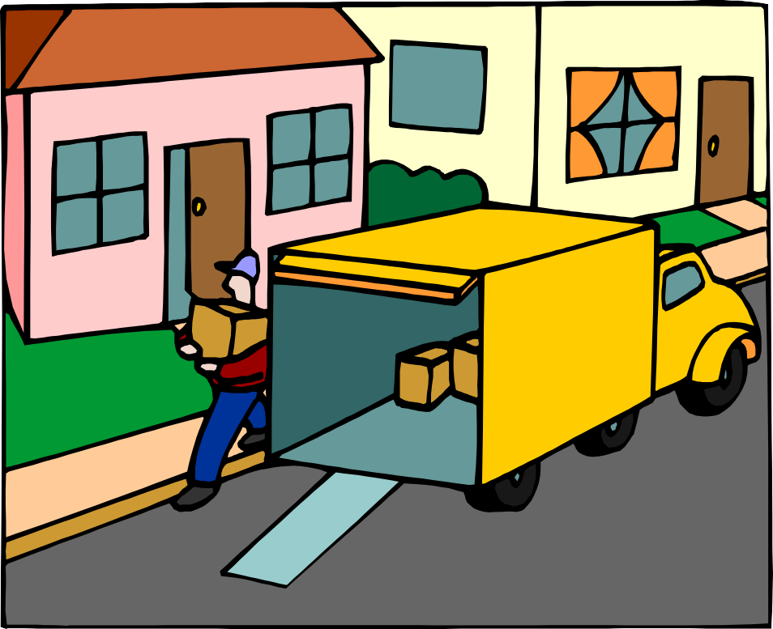

Downloading a package
Applets must be encapsulated in a package
External processes
Compile the applets
Verify the bytecode
Create a jar-like container
CAP file
Will be seen later
–
Package and applets are associated an identifier for future selection
Java Card 3.0 Programming

Slide 42
What is a Java Card Applet
A java object which is
Running using the JVM
Controlled by the JCRE
The class of this object must extend the class javacard.framework.Applet
The class must overload several methods
package ePurse;
import javacard.framework.*; class EPurse extends Applet {
short balance;
public EPurse(){…}
public static void install(…){…} public boolean select(){…} public void process(APDU apdu)
{…}
}
Java Card 3.0 Programming

Slide 43

Class APDU
This class provides the basic features needed to handle the ISO7816 protocol from the applet point of view
It gives access to the internal buffer dedicated to the communication
This buffer can be
Retrieved by the applet
Filled up by the applet and sent to the CAD
CLA
INS
P1
P2
LC
•
Java Card 3.0 Programming

Slide 44
Main methods of the APDU
byte buffer[] = apdu.getBuffer();
apdu.setIncomingAndReceive();
short le = apdu.setOutgoing(); apdu.setOutgoingLength(le); apdu.sendBytes(ISO7816.OFFSET_CDATA,
le);
apdu.setOutgoingAndSend(...);
These methods help to
Get the internal buffer
Start receiving data
Acknowledgement
Start transmitting data
Utilities help to
Transform 2 bytes in a short and vice versa
Copy buffers
Compare buffers
•
Java Card 3.0 Programming

Slide 45
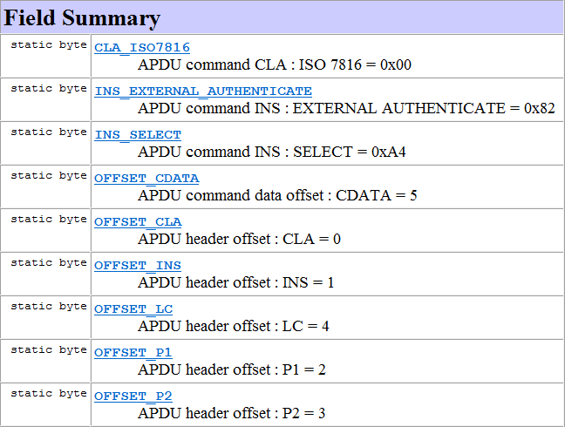
Class ISO7816
This class encapsulates most of the ISO7816 constants needed to program the applets
Constants are prefixed by
CLA for class related constants
INS for instruction related constants
OFFSET for offsets in the buffer
SW for status word related constants
Java Card 3.0 Programming

Slide 46
Build and load a Javacard Package
The java applet source code is compiled and converted in a CAP file
The CAP file is a Javacard package
The CAP file is loaded in the Javacard using several specific APDU command handled by the JCRE (JavaCard Runtime Environment)
MyApplet.java
MyApplet.class
MyApplet.cap
Javac
Javacard
converter
MyApplet.cap
Loader
Java Card 3.0 Programming

Slide 47
Lifecycle of an applet
The JCRE downloads the package containing the Applet
It calls the static method
install on the Applet
This method creates an instance
– Or more
And register this instance using an AID
instance aid
instance
register
JCRE
•
new
install
Applet
Java Card 3.0 Programming

Slide 48
Lifecycle of an Applet
instance aid
When the instance is created and registered it can be called
The JCRE can
select
deselect
the instance
Can call the instance to
process an APDU
instance
select
process
JCRE
deselect
Applet
Java Card 3.0 Programming

Slide 49
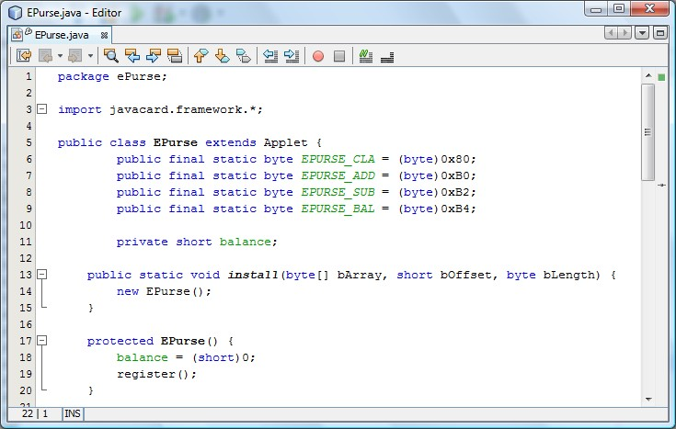
Example of an Applet
Java Card 3.0 Programming

Slide 50
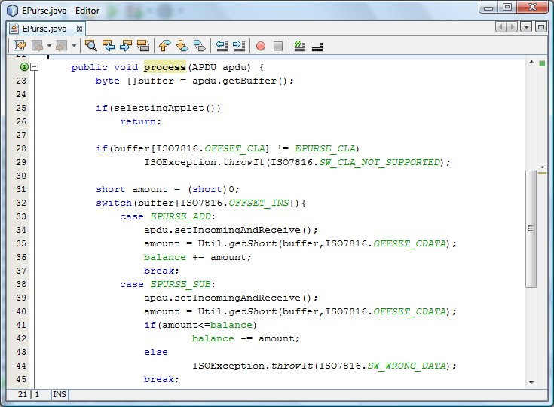
Java Card 3.0 Programming

Slide 51
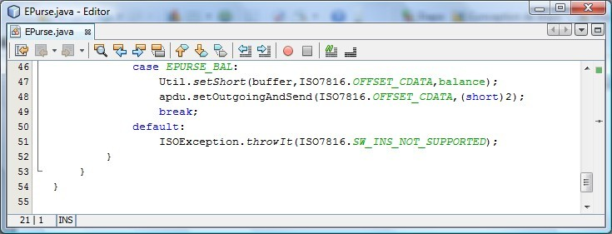
Java Card 3.0 Programming

Slide 52
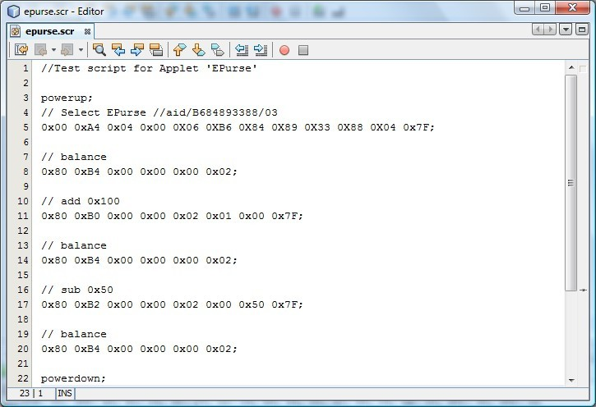
Simulation script
Java Card 3.0 Programming

Slide 53
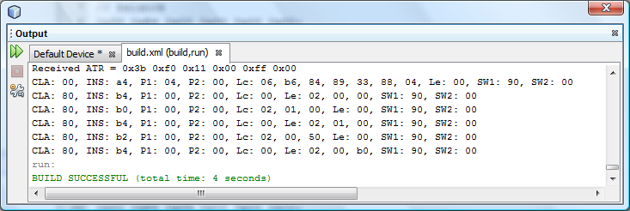
Result
Java Card 3.0 Programming

Slide 54
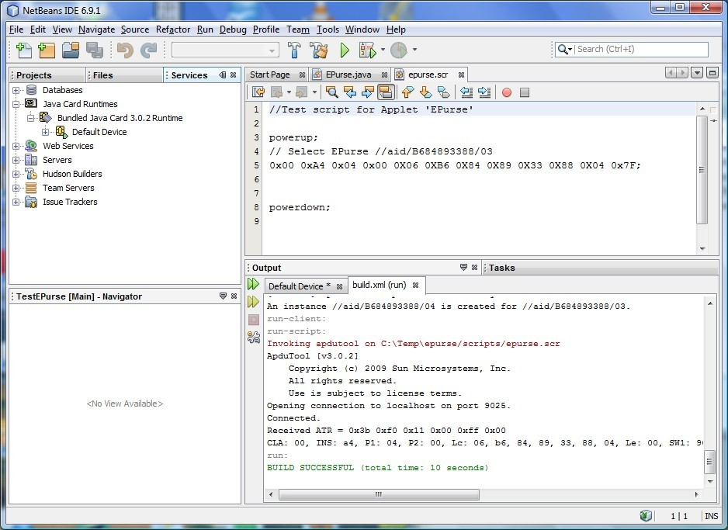
Netbeans
Java Card 3.0 Programming

Slide 55

Other Java Card features
Many features available
PIN code management
Transaction handling using JCSystem
Possibility to group together a certain number of actions into a transaction
Possibility to abort or commit the transaction
Shareable applets
Possibility to have several applets selected at the same time
Java Card 3.0 Programming

Slide 56
OwnerPIN
This class helps the developer to protect the access to some features of the smart card using a PIN code
private OwnerPIN pinCode;
/** Creates a new instance of EPurse */
public EPurse() { balance = (short)0;
pinCode = new OwnerPIN(EPURSE_PIN_TRY_LIMIT,
EPURSE_PIN_MAX_SIZE);
}
Java Card 3.0 Programming

Slide 57
OwnerPIN
The CAD must validate the PIN code prior to access the other features
case EPURSE_ADD: apdu.setIncomingAndReceive(); if(!pinCode.isValidated())
ISOException. throwIt(
ISO7816.SW_SECURITY_STATUS_NOT_SATISFIED);
break;
case EPURSE_PIN: apdu.setIncomingAndReceive(); if(!pinCode.check(buffer,
ISO7816.OFFSET_CDATA, EPURSE_PIN_MAX_SIZE))
ISOException.throwIt(
ISO7816.SW_SECURITY_STATUS_NOT_SATISFIED);
break;
Java Card 3.0 Programming

Slide 58
OwnerPIN
The OwnerPIN proposes a method to unblock a blocked PIN code (after a TRY_LIMIT unsuccessful attempts)
case EPURSE_UNBLOCK:
pinCode.resetAndUnblock();
Java Card 3.0 Programming

Slide 59
OwnerPIN
The OwnerPIN proposes a method to reset the
validated flag
public boolean select(){ pinCode.reset();
}
Java Card 3.0 Programming

Slide 60
Conclusion
●
In this chapter, we have seen
An introduction to the Java Card system What is a Java Card Applet
What is the Java Card Runtime Environment The lifecycle of an Applet
How to protect access with an OwnerPIN
●
●
●
●
●
Java Card 3.0 Programming

Slide 61
Cours 3: The key rules for Javacard Programming
Java Card 3.0 Programming

Slide 62
Java Card Programming Issues
Reduced language Reduced library
Most exciting features of Java available in Java Card
Most difficulties coming from the ISO7816 protocol hidden by the JCRE and the API
●
Programming a Java Card seems simple
●
●
●
●
Java Card 3.0 Programming

Slide 63
Java Card Programming Issues
●
Powerful tools help developing applets
●
Basic toolkit available for free from Sun (Oracle)
–
Helps testing and debugging applets
●
Enhanced toolkits provided by most of the manufacturers to
–
–
Upload applets in target Java Cards Test, on board, the uploaded applets
Java Card 3.0 Programming

Slide 64
Java Card Programming Issues
No consistency in data when the card is teared suddenly from the reader
Poor usability and security
Time out and memory issues not taken in account
●
Most of the trainee’s applets suffer from the following drawbacks:
●
●
●
Java Card 3.0 Programming

Slide 65
Tr U S T Me
●
A Java Card applet must be
●
Transaction aware
Usable Secure
Time-out aware
Memory aware
●
●
●
●
Java Card 3.0 Programming

Slide 66
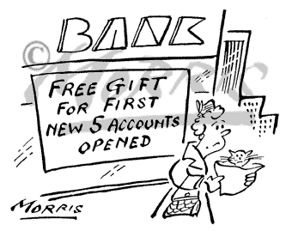
Transaction aware
●
Context
●
Memorize the ten last operations for an e- purse
Operation is qualified by
●
–
–
–
The type The amount The date
Java Card 3.0 Programming

Slide 67
Transaction aware (code example)
case EPURSE_ADD: apdu.setIncomingAndReceive(); if(!pinCode.isValidated())
ISOException.throwIt(
ISO7816.SW_SECURITY_STATUS_NOT_SATISFIED);
amount = Util.getShort(buffer, ISO7816.OFFSET_CDATA); balance = (short)(balance + amount);
list.add(buffer, ISO7816.OFFSET_INS,
ISO7816.OFFSET_CDATA, (short)2, (short)(ISO7816.OFFSET_CDATA + (short)2),
(short)8);
break;
Java Card 3.0 Programming

Slide 68
Transaction aware
(a better code)
…
try{
JCSystem.beginTransaction();
amount = Util.getShort(buffer, ISO7816.OFFSET_CDATA); balance = (short)(balance + amount);
list.add(buffer, ISO7816.OFFSET_INS, ISO7816.OFFSET_CDATA, (short)2, (short)(ISO7816.OFFSET_CDATA + (short)2),
(short)8);
JCSystem.commitTransaction();
}catch(TransactionException ex){ … }
break;
Java Card 3.0 Programming

Slide 69
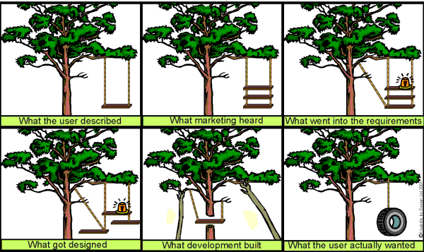
Usability
●
Context
●
On an e-purse, each operation must be accepted only if the user’s PIN code had been validated and if the operation is possible
Java Card 3.0 Programming

Slide 70
Usability
(code example)
case EPURSE_ADD: apdu.setIncomingAndReceive();
if(! pincode.check(buffer, ISO7816.OFFSET_CDATA, (byte)2)) ISOException.throwIt(ISO7816.SW_SECURITY_STATUS_NOT_SATISFIED);
amount =
Util.getShort(buffer, (short)(ISO7816.OFFSET_CDATA + (short)2)); balance = (short)(balance + amount);
list.add(buffer, ISO7816.OFFSET_INS,
(short)(ISO7816.OFFSET_CDATA + (short)2), (short)2, (short)(ISO7816.OFFSET_CDATA + (short)4),
(short)8);
break;
Java Card 3.0 Programming

Slide 71
Usability
●
PIN code must not be checked at each operation
●
But at each session starting
●
PIN code must be deselected after the applet had been also deselected
Java Card 3.0 Programming

Slide 72

Security
●
Context
●
Iris scan security system with the card holder’s iris characteristics in a smart card
Problem:
●
–
Which part of the system must decide if the iris scanned
corresponds to the data stored in the smart card:
●
The card acceptance device? The Java Card?
●
Java Card 3.0 Programming

Slide 73
Security
(proposed answers)
●
Answer 1:
The scanned data are passed to the smart card which returns yes or no!
Answer 2:
●
●
●
The Card Acceptance Device get the stored data from the card to compare it with the scanned data
Java Card 3.0 Programming

Slide 74
Security
●
Mutual authentication is needed prior any data exchange
Card Acceptance Device
●
●
which is more difficult to replace by a forged one
must make the comparison between data stored in the card and the data scanned
Java Card 3.0 Programming

Slide 75
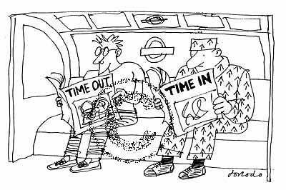
Time out
●
Context
●
A message is sent to the Java Card to be encrypted using a first command
A second command must be issued to get back the encrypted message
●
Java Card 3.0 Programming

Slide 76
Time out
(time issues)
●
What if
The Java card is teared from the card reader after the first command arrives and before the second command is issued
Or if
●
●
●
The second command arrives before the first one is issued
Java Card 3.0 Programming

Slide 77
Time out
●
Time out aware applet
●
Must blank the message to be encrypted if deselect and/or select is called before the second command is issued
Must refuse the second command if the first was not sent before
●
Java Card 3.0 Programming

Slide 78


Memory aware
●
Context
●
Memorize the ten last operations for an e-purse Operation is qualified by
●
–
–
–
The type The amount The date
Java Card 3.0 Programming

Slide 79
Memory aware
(code example)
case EPURSE_ADD: apdu.setIncomingAndReceive();
amount = Util.getShort(buffer, ISO7816.OFFSET_CDATA); Operation op = new Operation(buffer,
ISO7816.OFFSET_INS,ISO7816.OFFSET_CDATA, (short)2,
(short)(ISO7816.OFFSET_CDATA + (short)2), (short)8); list.add(op);
break;
Java Card 3.0 Programming

Slide 80
Memory aware
Avoid creating object on the fly
Create all the objects needed during construction phase
Recycle already created objects
●
More Memory aware code
●
●
●
Java Card 3.0 Programming

Slide 81
Conclusion
●
At the beginning, smart card programming was done:
●
In assembly language At a low level
By engineers aware of the
●
●
–
–
–
–
–
Transactions Usability Security Time-out
Memory usage
Java Card 3.0 Programming

Slide 82
Conclusion
●
Today, thanks to Java Card, applet programming can be done:
●
In Java
At a high level
By simple Java programmers
●
●
Java Card 3.0 Programming

Slide 83
Conclusion
●
The Java Card programmers must be aware of:
Transactions Usability Security Time out
Memory usage
●
●
●
●
●
Java Card 3.0 Programming

Slide 84
Cours 4: Security
Hardware and software aspects
Smart cards tutorial

Slide 85

Objectives
In this chapter, we'll see
An introduction about the security aspects of the smart cards
From a hardware point of view
From a software point of view
Smart cards tutorial

Slide 86

Hardware security
A smart card contains important data
It could contain
money (Electronic purses)
Keys (EMV Credit Card)
Sensitive Info (Fingerprint)
It must be tamper resistant
"If you know the attack you can build the shield"
Smart cards tutorial

Slide 87



The attacks
X raying the micro-chip
Measuring the power consumption variation during critical APDU
When the PIN code is transmitted for example
Measuring the answer delay
To try to predict what branches in the program are completed
Smart cards tutorial

Slide 88

The Counter Measure
The micro-chip uses an internal shield to protect itself against an X-Ray scanning
It guarantees the same delay for both branches of an alternative statement
It guarantees the same power consumption in all cases
Introduce lure (Random delay, fake processing)
Smart cards tutorial

Slide 89
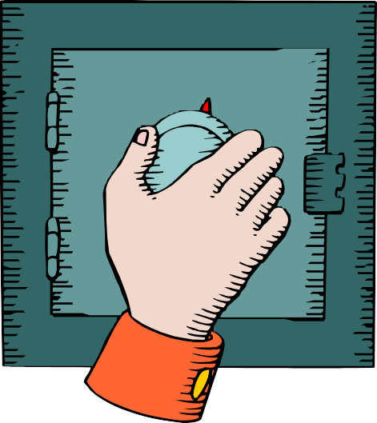

Software attacks and shields
•
Data are protected using cryptography
Various techniques
DES, DES3, AES
RSA, ECC
SHA
Cryptography is based on
A public algorithm
A key
Secret (DES, DES3, AES)
Private/Public (RSA,ECC)
Smart cards tutorial

Slide 90



Symmetric Enciphering
Bob
SAME KEY
Alice
Smart cards tutorial

Slide 91
Symmetric Enciphering
ENCRYPTION:
encryptedData = f(K ,message)
message= f (K, encryptedData )
Same key
DECRYPTION:
-1
f is the cryptographic function
K is the secret key
Message : the message to encrypt
The most popular crypto algorithm used in SmartCard is 3DES (Data Encryption system) and
AES (Advence d Encryption Standard)
Smart cards tutorial

Slide 92



Asymmetric enciphering
Bob’s private key (decyrption key)
Bob
Bob’s Public Key (encryption key)
Alice
Smart cards tutorial

Slide 93
Asymmetric enciphering
encryptedData = f (PublicKey , message)
message = f (PrivateKey , encryptedData )
Different key
-1
f is the cryptographic function
PublicKey & PrivateKey is the key pair
Message : the message to encrypt
PublicKey : used to encrypt
PrivateKey : used to decrypt
The most popular crypto algorithm used in SmartCard is RSA
(https://fr.wikipedia.org/wiki/Chiffrement_RSA)
Smart cards tutorial

Slide 94



Signing using asymmetric keys
Bob’s private key
Bob
Bob’s Public Key
Alice
Smart cards tutorial

Slide 95
Signing using asymmetric keys
signature= sign(PrivateKey, dataToSign)
boolean = verify(PublicKey , encryptedData , dataToSign)
PublicKey & PrivateKey is the key pair
datatoSign: the message to sign
PublicKey : used to encrypt
PrivateKey : used to decrypt
The most popular crypto algorithm used in SmartCard is RSA
(https://fr.wikipedia.org/wiki/Chiffrement_RSA)
Smart cards tutorial

Slide 96
Certify public key
X509 Certificate
•Subject (name, company, e-mail …)
•Issuer’s subject
•Public Key
Smart cards tutorial

Slide 97
Certification Authority
Certificate
•Subject (name, company, e-mail …)
•Start Date
•End Date
•Issuer’s subject
•Public Key
Self Signed
Thawte, Verisign,
...
Certificate
•Subject (name, company, e-mail …)
•Start Date
•End Date
•Issuer’s subject
•Public Key
Certificate
•Subject (name, company, e-mail …)
•Start Date
•End Date
•Issuer’s subject
•Public Key
Certificate
•Subject (name, company, e-mail …)
•Start Date
•End Date
•Issuer’s subject
•Public Key
Smart cards tutorial

Slide 98

Authentication
Authorization
Privacy
Integrity
Non-repudiation
Smart cards tutorial

Slide 99
Protect private key With Smart cards
•
The Private key is born, lives and dies inside the card
Key pair generation
Secure access
Cryptographic algorithm process inside the card
Physically secure
No hard drive storage of the private key
Portable
No multi-key
Multiple Device
Enciphering is done inside the card
Computer Independent
Smart cards tutorial

Slide 100

Hashing
Document
Modifying one bit completely changes the Hash
•Hash result is completely unpredictable
Hash
Standard algorithm is now SHA256, MD5 and SHA-1 are obsolete
8365923334
Smart cards tutorial

Slide 101



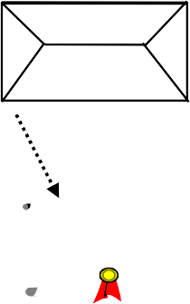

Digital Signature (Email)
Sender
Receiver
X.509
Kps
Sender’s private
Sender's PK
key & X509
certificate
Kss
Sender's SK
Letter
Letter
8365923334
Hash
8365923334
Hash
Signing
X.509
X.509
=?
Identification/ Authentication of the content of the
letter
Digital Signature
8A!G@3&04
CA Public key (certificate checked)
Certificate Authority
Smart cards tutorial

Slide 102

S/MIME Encryption
Sender
Receiver
Message
- generate "symmetric document key" (PC)
- unwrap document key with the receiver’s private key
- encrypt message with symmetric key (PC)
$@/!&@#
Encrypted message
- get certificate of receiver, verify certificate and extract public key
Kpr
- decrypt message
with " sym document key
X.509
Message
- encrypt "sym document key" with receiver’s public key
Trust Centre
Smart cards tutorial

Slide 103
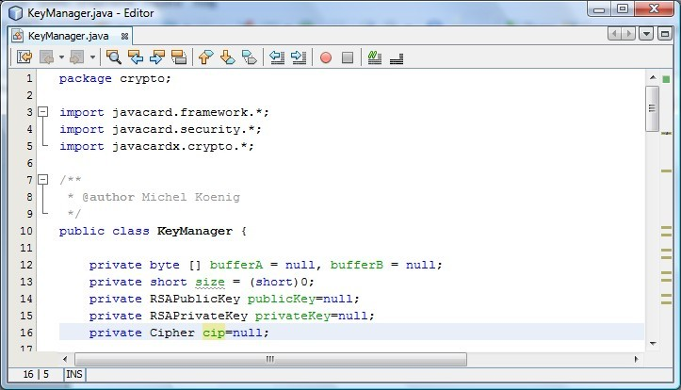
Example
Smart cards tutorial

Slide 104
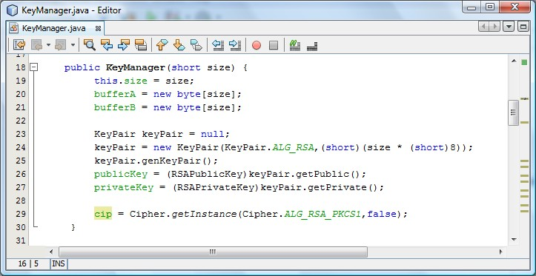
Example
Smart cards tutorial

Slide 105
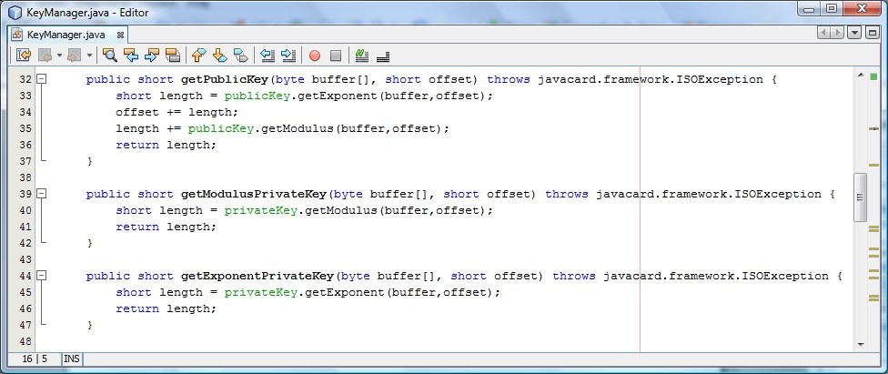
Example
Smart cards tutorial

Slide 106
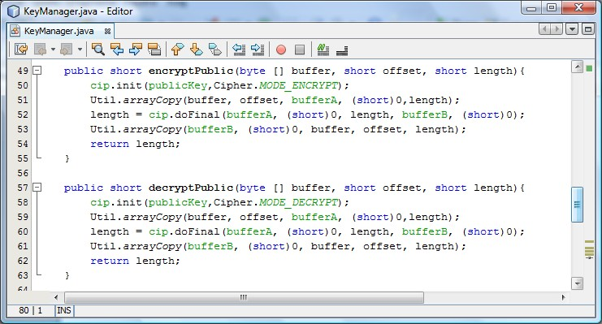
Example
Smart cards tutorial

Slide 107
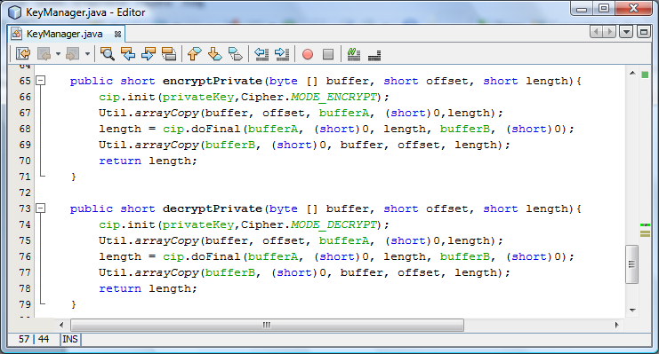
Example
Smart cards tutorial

Slide 108
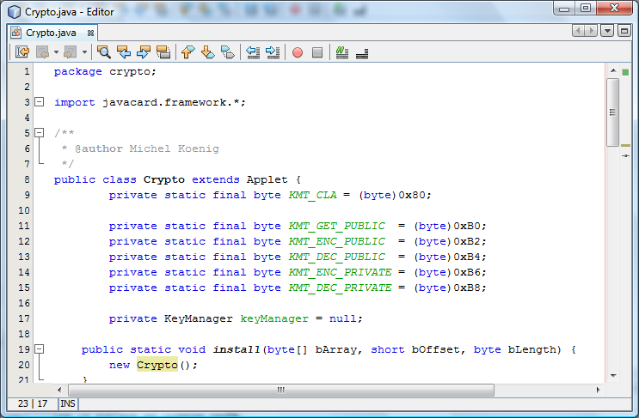
Example
Smart cards tutorial

Slide 109
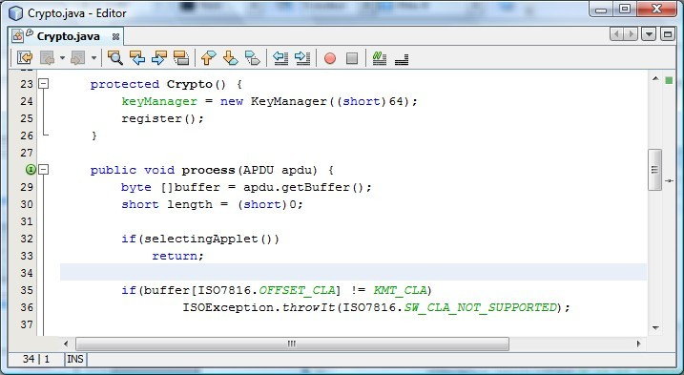
Example
Smart cards tutorial

Slide 110
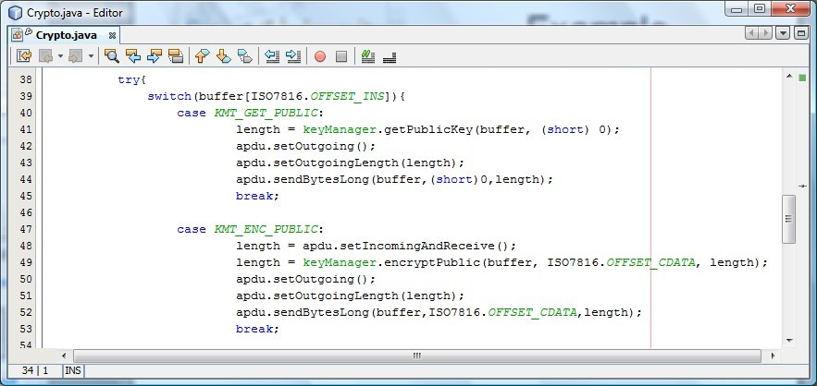
Example
Smart cards tutorial

Slide 111
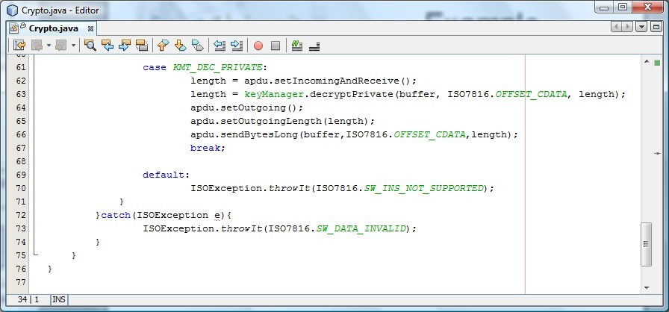
Example
Smart cards tutorial

Slide 112
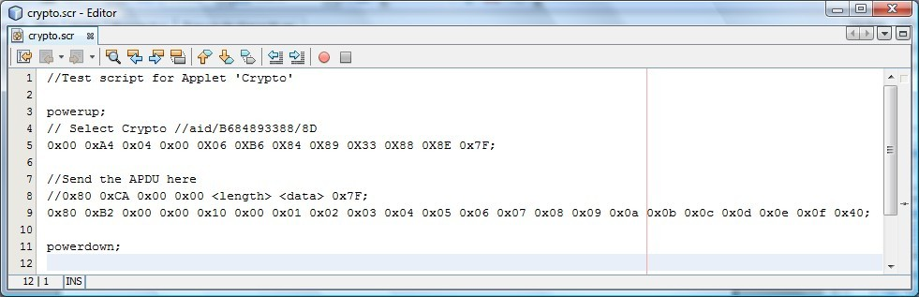
Encrypting w/public
Smart cards tutorial

Slide 113
Result
CLA: | 00, | INS: | a4, P1: 04, P2: 00, Lc: 06, b6, 84, 89, 33, 88, 8E, 8F Le:00
SW1: | 90, | SW2: | 00
CLA: | 80, | INS: | b2, P1: 00, P2: 00, Lc: 10,
00, | 01, | 02, | 03, | 04, | 05, | 06, | 07, | 08, | 09, | 0a, | 0b, | 0c, | 0d, | 0e, | 0f,
Le: | 40,
66, | ff, | e8, | 04, | 8a, | 41, | 9e, | c2, | dd, | e7, | 44, | 08, | a5, | 41, | c2, | e5,
79, | 3d, | 65, | 31, | a5, | c6, | c8, | 54, | bd, | 49, | 52, | eb, | d3, | 65, | 0e, | b6,
da, | 99, | f0, | e4, | 89, | b6, | 08, | a4, | f6, | 64, | f9, | 3d, | ba, | bb, | 93, | 61,
f8, | a4, | 95, | 3a, | 13, | 2d, | 17, | 73, | 7b, | 4c, | 49, | 27, | 9f, | 1e, | 8c, | 9c,
SW1:90,
SW2:00
Smart cards tutorial

Slide 114

Conclusion
In this chapter, we have seen
An introduction about the security aspects of the smart cards
From a hardware point of view
From a software point of view
Smart cards tutorial

Slide 115
SIM Cards
Proactive SIM cards
Smart cards tutorial

Slide 116
Introduction
In this chapter, we'll see
The standards driving the smart cards for mobile telephony
What is the SIM Toolkit
How Java Card handles the SIM toolkit
A full example of a Java Card applet built using the SIM Toolkit library
●
●
●
●
●
Smart cards tutorial

Slide 117
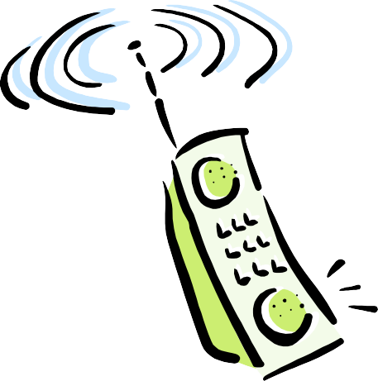

SIM cards
Standardized by ETSI for GSM
• GSM 11.11 V6.1.0
SIM specs
Subscriber Identification Module
GSM 11.14 V7.1.0
SIM Toolkit specs
• GSM 03.19 V1.0.0
Javacard SIM API
•
Smart cards tutorial

Slide 118
SIM cards
The SIM Card is used to authenticate the subscriber to the operator network
The SIM Card contains network operator configuration
Smart cards tutorial

Slide 119
Proactives SIM
Using the SIM Toolkit, possibility to
Program the SIM
Make the SIM card application driving the phone
Access to keyboard, display, …
Smart cards tutorial

Slide 120
Internal organization
The SIM contains a certain number of "files" grouped into "directories"
Terminology:
Element File: file
Dedicated File: directory
Root 0x3F00
Directory 0x2345
File 0x2222
File 0x2A34
Smart cards tutorial

Slide 121
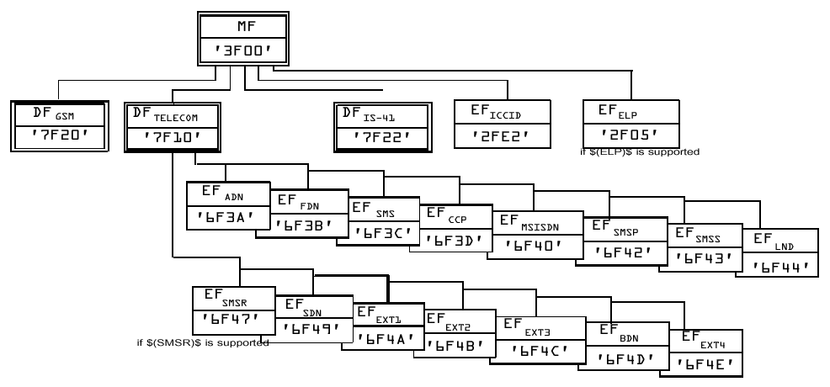
File hierarchy
Smart cards tutorial

Slide 122
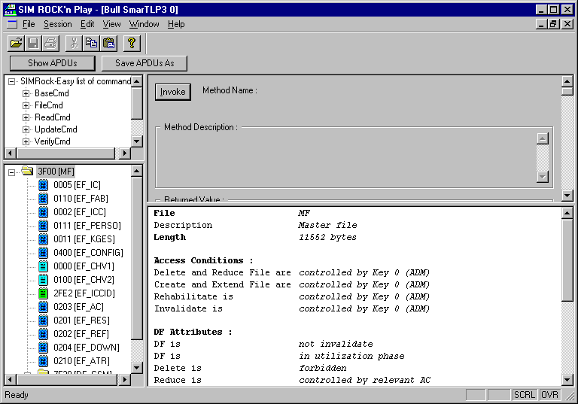
File hierarchy
Smart cards tutorial

Slide 123

Proactive SIM
The ISO7816 standard does not permit that the card starts talking first
– A card is waiting for an APDU and responds when it receives the APDU
Proactive SIM cards use a specific status word to indicate to the Mobile Equipment that they want to talk to it
Smart cards tutorial

Slide 124

Proactive protocol
Smart cards tutorial

Slide 125


Allowed commands for the SIM
The SIM card can
Display text on the phone display
Prompt User to input data from the keyboard
Play tone
Send a SMS
Process an incoming SMS
– …
Smart cards tutorial

Slide 126
SIM Toolkit applet
A SIM Toolkit applet must
Import sim.access and sim.toolkit packages
Extend the javacard.framework.Applet
Implement the interfaces
ToolkitInterface
ToolkitConstants
Smart cards tutorial

Slide 127
SIM Toolkit applet
Example:
import import import
sim.toolkit.*; sim.access.*; javacard.framework.*;
public
class MyApplet1 extends javacard.framework.Applet implements
ToolkitInterface, ToolkitConstants {
// Mandatory variables
private SIMView gsmFile;
private ToolkitRegistry reg;
Smart cards tutorial

Slide 128
SIMView
The SIMView interface is the interface between the applet and the GSM filesystem
It proposes
Constants to identify in a simple way the regular GSM files
Methods to access these files
Smart cards tutorial

Slide 129
SIMView
Example:
/** DF under MF */
/** File identifier public static final
/** File identifier public static final
/** File identifier public static final
/** File identifier public static final
/** File identifier
: DF TELECOM = 0x7F10 */
short FID_DF_TELECOM
: DF GSM = 0x7F20 */
short FID_DF_GSM
= (short)0x7F10;
= (short)0x7F20;
: DF DCS-1800 = 0x7F21 */
short FID_DF_DCS_1800
: DF IS-41 = 0x7F22 */
short FID_DF_IS_41
= (short)0x7F21;
= (short)0x7F22;
: DF FP-CTS = 0x7F23 */
Smart cards tutorial

Slide 130
SIMView
Example:
public short select(short
short short
fid, byte fci[], fciOffset,
fciLength) throws
ArrayIndexOutOfBoundsExceptio; SIMViewException, NullPointerException,
Smart cards tutorial

Slide 131
SIMSystem
The SIMSystem class provides one method which is
– SIMView
getTheSIMView()
Smart cards tutorial

Slide 132
ToolkitRegistry
The SIM Applet communicates with the mobile equipment through the ToolkitRegistry
The SIM applet get an entry from the
ToolkitRegistry in order
To receive and process the events sent by the mobile equipment
To send command to the mobile equipment
Smart cards tutorial

Slide 133
SIM Toolkit applet
Example
// Main private private
Menu
byte idMenu1;
byte[] Menu1;
public MyApplet1() {
// Get the GSM application reference gsmFile = SIMSystem.getTheSIMView();
// Get the reference of the applet ToolkitRegistry object reg = ToolkitRegistry.getEntry();
/**@todo: Customize your menu titles here*/
Menu1 = new byte[] { (byte) '1', (byte) ' ', (byte) 'M', (byte) 'e',
(byte) 'n', (byte) 'u', (byte) '1' };
// Define the applet Menu Entry idMenu1 = reg.initMenuEntry(Menu1, PRO_CMD_SELECT_ITEM, false, (byte)
}
(short) 0, (short) Menu1.length, 0, (short) 0);
Smart cards tutorial

Slide 134
initMenuEntry
public byte initMenuEntry(
byte[] menuEntry,
short offset,
short length,
byte nextAction,
boolean helpSupported, byte iconQualifier, short iconIdentifier
// the menu entry string
// its offset
// its length
// next action to execute when
menu is selected
// true if help available
// 0 is no icon
)
throws java.lang.NullPointerException, java.lang.ArrayIndexOutOfBoundsException, ToolkitException,
TransactionException
Smart cards tutorial

Slide 135
SIM Toolkit applet
/**
called by the JCRE at the installation of the applet bArray the byte array containing the AID bytes bOffset the start of AID bytes in bArray
bLength the length of the AID bytes in bArray
Method
@param
@param
@param
*/
public static void install(byte[] bArray, short bOffset, byte bLength) {
// Create the Java SIM toolkit applet
MyApplet1 StkCommandsExampleApplet = new MyApplet1();
// Register this applet StkCommandsExampleApplet.register(bArray, (short) (bOffset + 1), (byte) bArray[bOffset]);
}
Smart cards tutorial

Slide 136
SIM Toolkit applet
/**
Method called by the SIM Toolkit Framework
@param event the byte representation of the event triggered
*/
public void processToolkit(byte event) {
// Manage the request following the MENU SELECTION event type
if (event == EVENT_MENU_SELECTION) {
// Get the selected item
EnvelopeHandler envHdlr = EnvelopeHandler.getTheHandler();
byte selectedItemId = envHdlr.getItemIdentifier();
// Perform the required service following the Menu1 selected
// item
if (selectedItemId == idMenu1) { menu1Action();
}
Smart cards tutorial

Slide 137
SIM Toolkit applet
private byte [] helloWorld;
private void menu1Action() {
// Get the received envelope
ProactiveHandler proHdlr = ProactiveHandler.getTheHandler(); helloWorld = new byte[]{(byte)'H',(byte)'e',(byte)'l',(byte)'l',
(byte)'o',(byte)' ',(byte)'w',(byte)'o',(byte)'r',(byte)'l',(byte)'d'};
// Initialize the display text command
proHdlr.initDisplayText((byte) 0x00, DCS_8_BIT_DATA, helloWorld, (short) 0, (short) (helloWorld.length));
proHdlr.send();
return;
}
Smart cards tutorial

Slide 138


Running
Smart cards tutorial

Slide 139
Documentation
More documentation in
– 3gpp 43019-560
Smart cards tutorial

Slide 140
Conclusion
In this chapter, we have seen
The standards driving the smart cards for mobile telephony
What is the SIM Toolkit
How Java Card handles the SIM toolkit
A full example of a Java Card applet built using the SIM Toolkit library
●
●
●
●
●
Smart cards tutorial

Slide 141
Smart Card Web Server
An other way for the SIM card to control the handset
Smart cards tutorial

Slide 142
Introduction
In this chapter, we'll see:
A new approach to interface the applications in the SIM card, using the handset
The architecture of the SCWS
A full application for a SIM card supporting SCWS
●
●
●
●
Smart cards tutorial

Slide 143
Introduction
●
SIM Toolkit was introduced at the time when handset had few capabilities for interfacing
Text oriented display No graphics Hierachical menus
●
●
●
●
Modern handsets support
Full color graphic interface Point and pin menus
●
●
Smart cards tutorial

Slide 144
Introduction
●
Gemalto developers proposed at Cartes 2000 a simplified web server inside the SIM card
●
With
●
the introduction of the USB port and TCP/IP stack
the powerfulness of modern SIM card (32bits, NAND Flash)
●
Smart cards tutorial

Slide 145
SCWS
●
The standard adopted is called:
Smart Card Web Server This standard supposes
●
●
A TCP/IP link
–
On USB
●
A TCP/IP stack on board
Smart cards tutorial

Slide 146
SCWS
Applets
SCWS API
STK Api
SCWS
Javacard APIs
Java Virtual Machine
Low Level Resources
Smart cards tutorial

Slide 147
Packages and classes
/*
* Imported packages
*/
Import javacard.framework.*;
Import uicc.scws.HttpRequest;
Import uicc.scws.HttpResponse;
Import uicc.scws.ScwsConstants;
Import uicc.scws.ScwsException;
Import uicc.scws.ScwsExtension;
Import uicc.scws.ScwsExtensionRegistry;
Universal Integrated Circuit Card
Smart cards tutorial

Slide 148
ScwsConstants
MIME types
CONTENT_TYPE_IMAGE_GIF
CONTENT_TYPE_TEXT_HTML
Status code
– SC_OK (200)
SC_NOT_FOUND (404)
Parsing tags
URI_QUERY_TAG
Smart cards tutorial

Slide 149
ScwsExtension
The applet (servlet!) working in SCWS mode must implement ScwsExtension
That means overiding the methods
doGet()
doPost()
doHead()
– ...
Smart cards tutorial

Slide 150
HttpRequest
Not really the J2EE HttpRequest but enough to extract data from a HTTP request
Provides methods like
findAndCopyKeywordValue
getContentLength
getContentType
Smart cards tutorial

Slide 151
HttpResponse
As for HttpRequest, helps the user to provide an HTTP response to the request
Provides methods like
setContentType()
appendContent()
writeStatusCode()
flush()
Smart cards tutorial

Slide 152
Example
In the next servlet, the strings are encoded as arrays of bytes
– Strings are not supported by Java Card 2
In the next two pages, the pseudo code written in comment show how the servlet would be written if String was supported by this release of Java Card
Smart cards tutorial

Slide 153
Example
/*
public class HelloWorld extends javacard.framework.Applet implements AppletEvent, ScwsExtension {
public final static String url = "/HelloWorld"; public final static String appId = "HelloWorld;
public byte[] temporaryBuffer;
public final static short TEMPORARY_BUFFER_LENGTH = (short) 100;
public final static String HTML_BEGIN = "<html>"+"<head>"+
"<title>"+"Hello"+"</title>"+"</head>"+
"<body BGCOLOR=\"#FFFFFF\">"+"<center>"; public final static String HELLO = "Hello ";
public final static String HTML_END = "</center>"+"</body>"+ "</html>"
Smart cards tutorial

Slide 154
Example
Unfortunately String are not yet supported by Java Card
– Strings are supported by Java Card 3
The arrays of bytes are not so easy to read, but the result is the same
Smart cards tutorial

Slide 155
Example
public class HelloWorld extends javacard.framework.Applet implements AppletEvent, ScwsExtension {
/** the servlet url */
public final static byte[] url = { (byte)'/', (byte)'H', (byte)'e', (byte)'l', (byte)'l', (byte)'o', (byte)'W', (byte)'o', (byte)'r', (byte)'l', (byte)'d' };
public final static byte[] appId = { (byte)'H', (byte)'e', (byte)'l', (byte)'l', (byte)'o', (byte)'W', (byte)'o', (byte)'r', (byte)'l', (byte)'d' };
Smart cards tutorial

Slide 156
Example
// Temporary operation buffer
(byte)'<',(byte)'h',(byte)'t',(byte)'m',(byte)'l',(byte)'>',
(byte)'<',(byte)'h',(byte)'e',(byte)'a',(byte)'d',(byte)'>',
(byte)'<',(byte)'t',(byte)'i',(byte)'t',(byte)'l',(byte)'e',(byte)'>',
(byte)'H',(byte)'e',(byte)'l',(byte)'l',(byte)'o',
(byte)'<',(byte)'/',(byte)'t',(byte)'i',(byte)'t',(byte)'l',(byte)'e', (byte)'>',
(byte)'<',(byte)'/',(byte)'h',(byte)'e',(byte)'a',(byte)'d',(byte)'>',
public public public
byte[] temporaryBuffer;
final static short TEMPORARY_BUFFER_LENGTH = (short) 100; final static byte[] HTML_BEGIN = {
Smart cards tutorial

Slide 157
Example
(byte)'<',(byte)'b',(byte)'o',(byte)'d',(byte)'y',(byte)' ',
(byte)'B',(byte)'G',(byte)'C',(byte)'O',(byte)'L',(byte)'O',(byte)'R',
(byte)'=',(byte)'"',(byte)'#',(byte)'F',(byte)'F',(byte)'F',(byte)'F', (byte)'F',(byte)'F',(byte)'"',(byte)'>',
(byte)'<',(byte)'c',(byte)'e',(byte)'n',(byte)'t',(byte)'e',(byte)'r', (byte)'>'};
public final static byte[] HELLO ={(byte)'H',(byte)'e',(byte)'l',
(byte)'l',(byte)'o',(byte)' '};
public final static byte[] HTML_END = {
(byte)'<',(byte)'/',(byte)'c',(byte)'e',(byte)'n',(byte)'t',(byte)'e', (byte)'r',(byte)'>',
(byte)'<',(byte)'/',(byte)'b',(byte)'o',(byte)'d',(byte)'y',
(byte)'<',(byte)'/',(byte)'h',(byte)'t',(byte)'m',(byte)'l',(byte)'>'};
Smart cards tutorial

Slide 158
Example
public HelloWorld(byte[] buffer, short offset, byte length) {
// First LV is instance AID
short aid = offset;
offset += buffer[offset] + (byte) 1;
// LV is Privilege
offset += buffer[offset] + (byte) 1;
// Third LV is specific install parameter (extract from TAG C9)
offset ++;
// Register the new applet instance to the JCRE
register(buffer, (short) (aid + (short) 1), buffer[aid]);
// Run/Debug configuration for URL Mapping ScwsExtensionRegistry.register(this, appId, (short) 0,
(short) appId.length);
Smart cards tutorial

Slide 159
Example
try {
// Create a temporary buffer for read/write temporaryBuffer = JCSystem.makeTransientByteArray( TEMPORARY_BUFFER_LENGTH, JCSystem.CLEAR_ON_RESET);
} catch (SystemException se) {
// create buffer in persistent memory as not enough transient
// is available
temporaryBuffer = new byte[TEMPORARY_BUFFER_LENGTH];
}
Smart cards tutorial

Slide 160
Example
public void doGet(HttpRequest req, HttpResponse resp) throws ScwsException {
try {
resp.writeStatusCode(ScwsConstants.SC_OK); resp.setContentType(ScwsConstants.CONTENT_TYPE_TEXT_HTML); resp.enableChunkMode();
short queryLength = req.findAndCopyKeywordValue( ScwsConstants.URI_QUERY_TAG, temporaryBuffer,(short)0, (short)temporaryBuffer.length);
resp.appendContent(HTML_BEGIN,(short)0,(short)HTML_BEGIN.length); resp.appendContent(HELLO, (short)0, (short)HELLO.length); resp.appendContent(temporaryBuffer, (short)0, queryLength); resp.appendContent(HTML_END,(short)0, (short)HTML_END.length);
}catch(Exception e) {resp.writeStatusCode(ScwsConstants.SC_BAD_REQUEST);} resp.flush();
Smart cards tutorial

Slide 161
Static HTML
Static HTML file : helloworld.html
<html>
<body>
<p>Simagin
<br>
URI of the SCWS servlet
HelloWorld</p>
<form action="/HelloWorld" method="get">
<input name="name" type="text"> <br>
<input value="Type in your name" type="submit">
</form>
</body>
</html>
Smart cards tutorial

Slide 162



Running
Smart cards tutorial

Slide 163
Conclusion
In this chapter, we have seen:
A new approach to interface the applications in the SIM card, using the handset
The architecture of the SCWS
A full application for a SIM card supporting SCWS
●
●
●
Smart cards tutorial

Slide 164
Java Card 3.0 Connected Edition
A new and rich flavour of Java Card
Smart cards tutorial

Slide 165
Introduction
In this chapter, we'll see
The main enhancements introduced by Java Card 3
The restrictions of Java Card 3 compared to Java SE
A full example of a servlet
●
●
●
●
Smart cards tutorial

Slide 166
Features
●
Java Card 3.0 has two editions:
●
The Classic Edition
–
–
Compatible with Java Card 2 Applications are built with applets
●
The Connected Edition
–
–
With a WEB server embedded HTTP, TCP/IP over USB
Smart cards tutorial

Slide 167
Features
Java Card 3.0 classic edition remains applet oriented
Java Card 3.0 connected edition is servlet oriented
●
●
●
Specifications of the supported servlets are extracted from the Servlet API Specifications 2.4
–
Everything which deals with floating point numbers, J2EE, etc. are not taken in account.
Smart cards tutorial

Slide 168
Features
●
But, like traditionnal servlets, the Java Card 3 servlets support the methods:
doGet doPost doHead doPut doDelete doOptions doTrace
●
●
●
●
●
●
●
Smart cards tutorial

Slide 169
Features
●
Better support of the Java language
All data types except float and double Multiple threads
Extensive API support (java.lang, java.util, GCF, and so on)
Direct handling of class files, with all loading and linking on card
All new Java language syntax constructs, like enums, generics, enhanced for loops, auto boxing/unboxing, and so on
Automatic garbage collection
●
●
●
●
●
●
Smart cards tutorial

Slide 170

Architecture
Smart cards tutorial

Slide 171

Architecture
Smart cards tutorial

Slide 172
Example
The following example is created with NetBeans 6.9 with the Java Card wizard
It is the web instance of the very well known
« Hello world » program
●
●
●
Most code is automatically generated by the Java Card wizard
Smart cards tutorial

Slide 173

Example
Smart cards tutorial

Slide 174

Example
Smart cards tutorial

Slide 175

Example
Smart cards tutorial

Slide 176

Example
Smart cards tutorial

Slide 177

Example
Smart cards tutorial

Slide 178

Example
Smart cards tutorial

Slide 179

Example
Smart cards tutorial

Slide 180

Example
Smart cards tutorial

Slide 181

Example
Smart cards tutorial

Slide 182

Example
Smart cards tutorial

Slide 183

Example
Smart cards tutorial

Slide 184

Example
Smart cards tutorial

Slide 185

Example
Smart cards tutorial

Slide 186

Example
Smart cards tutorial

Slide 187
Conclusion
In this chapter, we have seen
The main enhancements introduced by Java Card 3
The restrictions of Java Card 3 compared to Java SE
A full example of a servlet
●
●
●
●
Smart cards tutorial

Slide 188
Conclusion
Smart cards tutorial

Slide 189
Conclusion
●
In 1996, the Java Card system changed dramatically the way to program secure applications for smart cards
Despite many concurents on the field, this system remains today the first language for smart cards in the world
Combined with Java for Mobile Equipment it represents the solution to develop secure applications for the future powerful smartphones
●
●
Smart cards tutorial

